Slide 1
Planetary Metabolism
Tokyo Institute
of Technology
Science of a Living Planet
John Hernlund

Slide 2
Earth-Life Science Institute
Tokyo Institute of Technology
Established in December 2012
Idea: Earth and Life are intimately coupled, inseparable. Target: Origin and evolution of the Earth-Life system.
“How do planets make life?”

Slide 3
Earth-Life Science Institute (2016 photo)
Ariel Anbar (Ariz State U)
Hilairy Hartnett (Ariz State U)
…and many more….

Slide 4
What is Life?

Slide 5
Workshop in Misasa, Japan (2014)
“Origin of life is an ill-posed problem, because there is no definition of life”
—熊沢峰夫 Mineo Kumazawa

Slide 6
What is Life?

Slide 7
Ostensible Traits of Life…
Homeostasis: Regulation of the internal environment to maintain a constant state; for example, electrolyte concentration or sweating to reduce temperature.
Organization: Being structurally composed of one or more cells — the basic units of life.
Metabolism: Transformation of energy by converting chemicals and energy into cellular components (anabolism) and decomposing organic matter (catabolism). Living things require energy to maintain internal organization (homeostasis) and to produce the other phenomena associated with life.
Growth: Maintenance of a higher rate of anabolism than catabolism. A growing organism increases in size in all of its parts, rather than simply accumulating matter.
Adaptation: The ability to change over time in response to the environment. This ability is fundamental to the process of evolution and is determined by the organism's heredity, diet, and external factors.
Response to stimuli: A response can take many forms, from the contraction of a unicellular organism to external chemicals, to complex reactions involving all the senses of multicellular organisms. A response is often expressed by motion; for example, the leaves of a plant turning toward the sun (phototropism), and chemotaxis.
Reproduction: The ability to produce new individual organisms, either asexually from a single parent organism, or sexually from two parent organisms or "with an error rate below the sustainability threshold."
Some Problems:
Not all “Life” has all of the same characteristics (exceptions to the rules)
“Non-Life” does the same analogous things (i.e., they are properties of complex systems rather than just biology)
Cross-over phenomena (e.g., viruses) blur the distinction

Slide 8
“Life is a self-sustaining chemical system capable of Darwinian evolution”
—Gerald Joyce
Some Problems:
Life is not “self-sustaining,” it intimately interacts with everything else and depends on it for sustenance.
Every macro phenomenon can be expressed as being fundamentally a product of chemistry.
Darwinian evolution is diversification and selection, which is pervasive in the non-biological as well as biological realm.

Slide 9
“A rock is not life because it doesn’t eat”
—Comment by workshop participant at ELSI
Some Problems (and Opportunities):
A rock is an object (thing), whereas life is a process (action).
Eating is an expression of the open system nature of the life process. Rocks are part of the environment, life shares the same matter and energy sources.
We spend a lot of effort trying to distinguish life from non-life, what is the point? Does it betray a closed system mentality? Is it useful for understanding?

Slide 10
Life is an open system
Food
Hair Loss
Drink
Exhalation
Inhalation
Skin Loss
You are not
your body
Urination
Most of your body is replaced every 3-7 years
Defecation
Nail Growth
Where does it come from, where does it go?

Slide 11
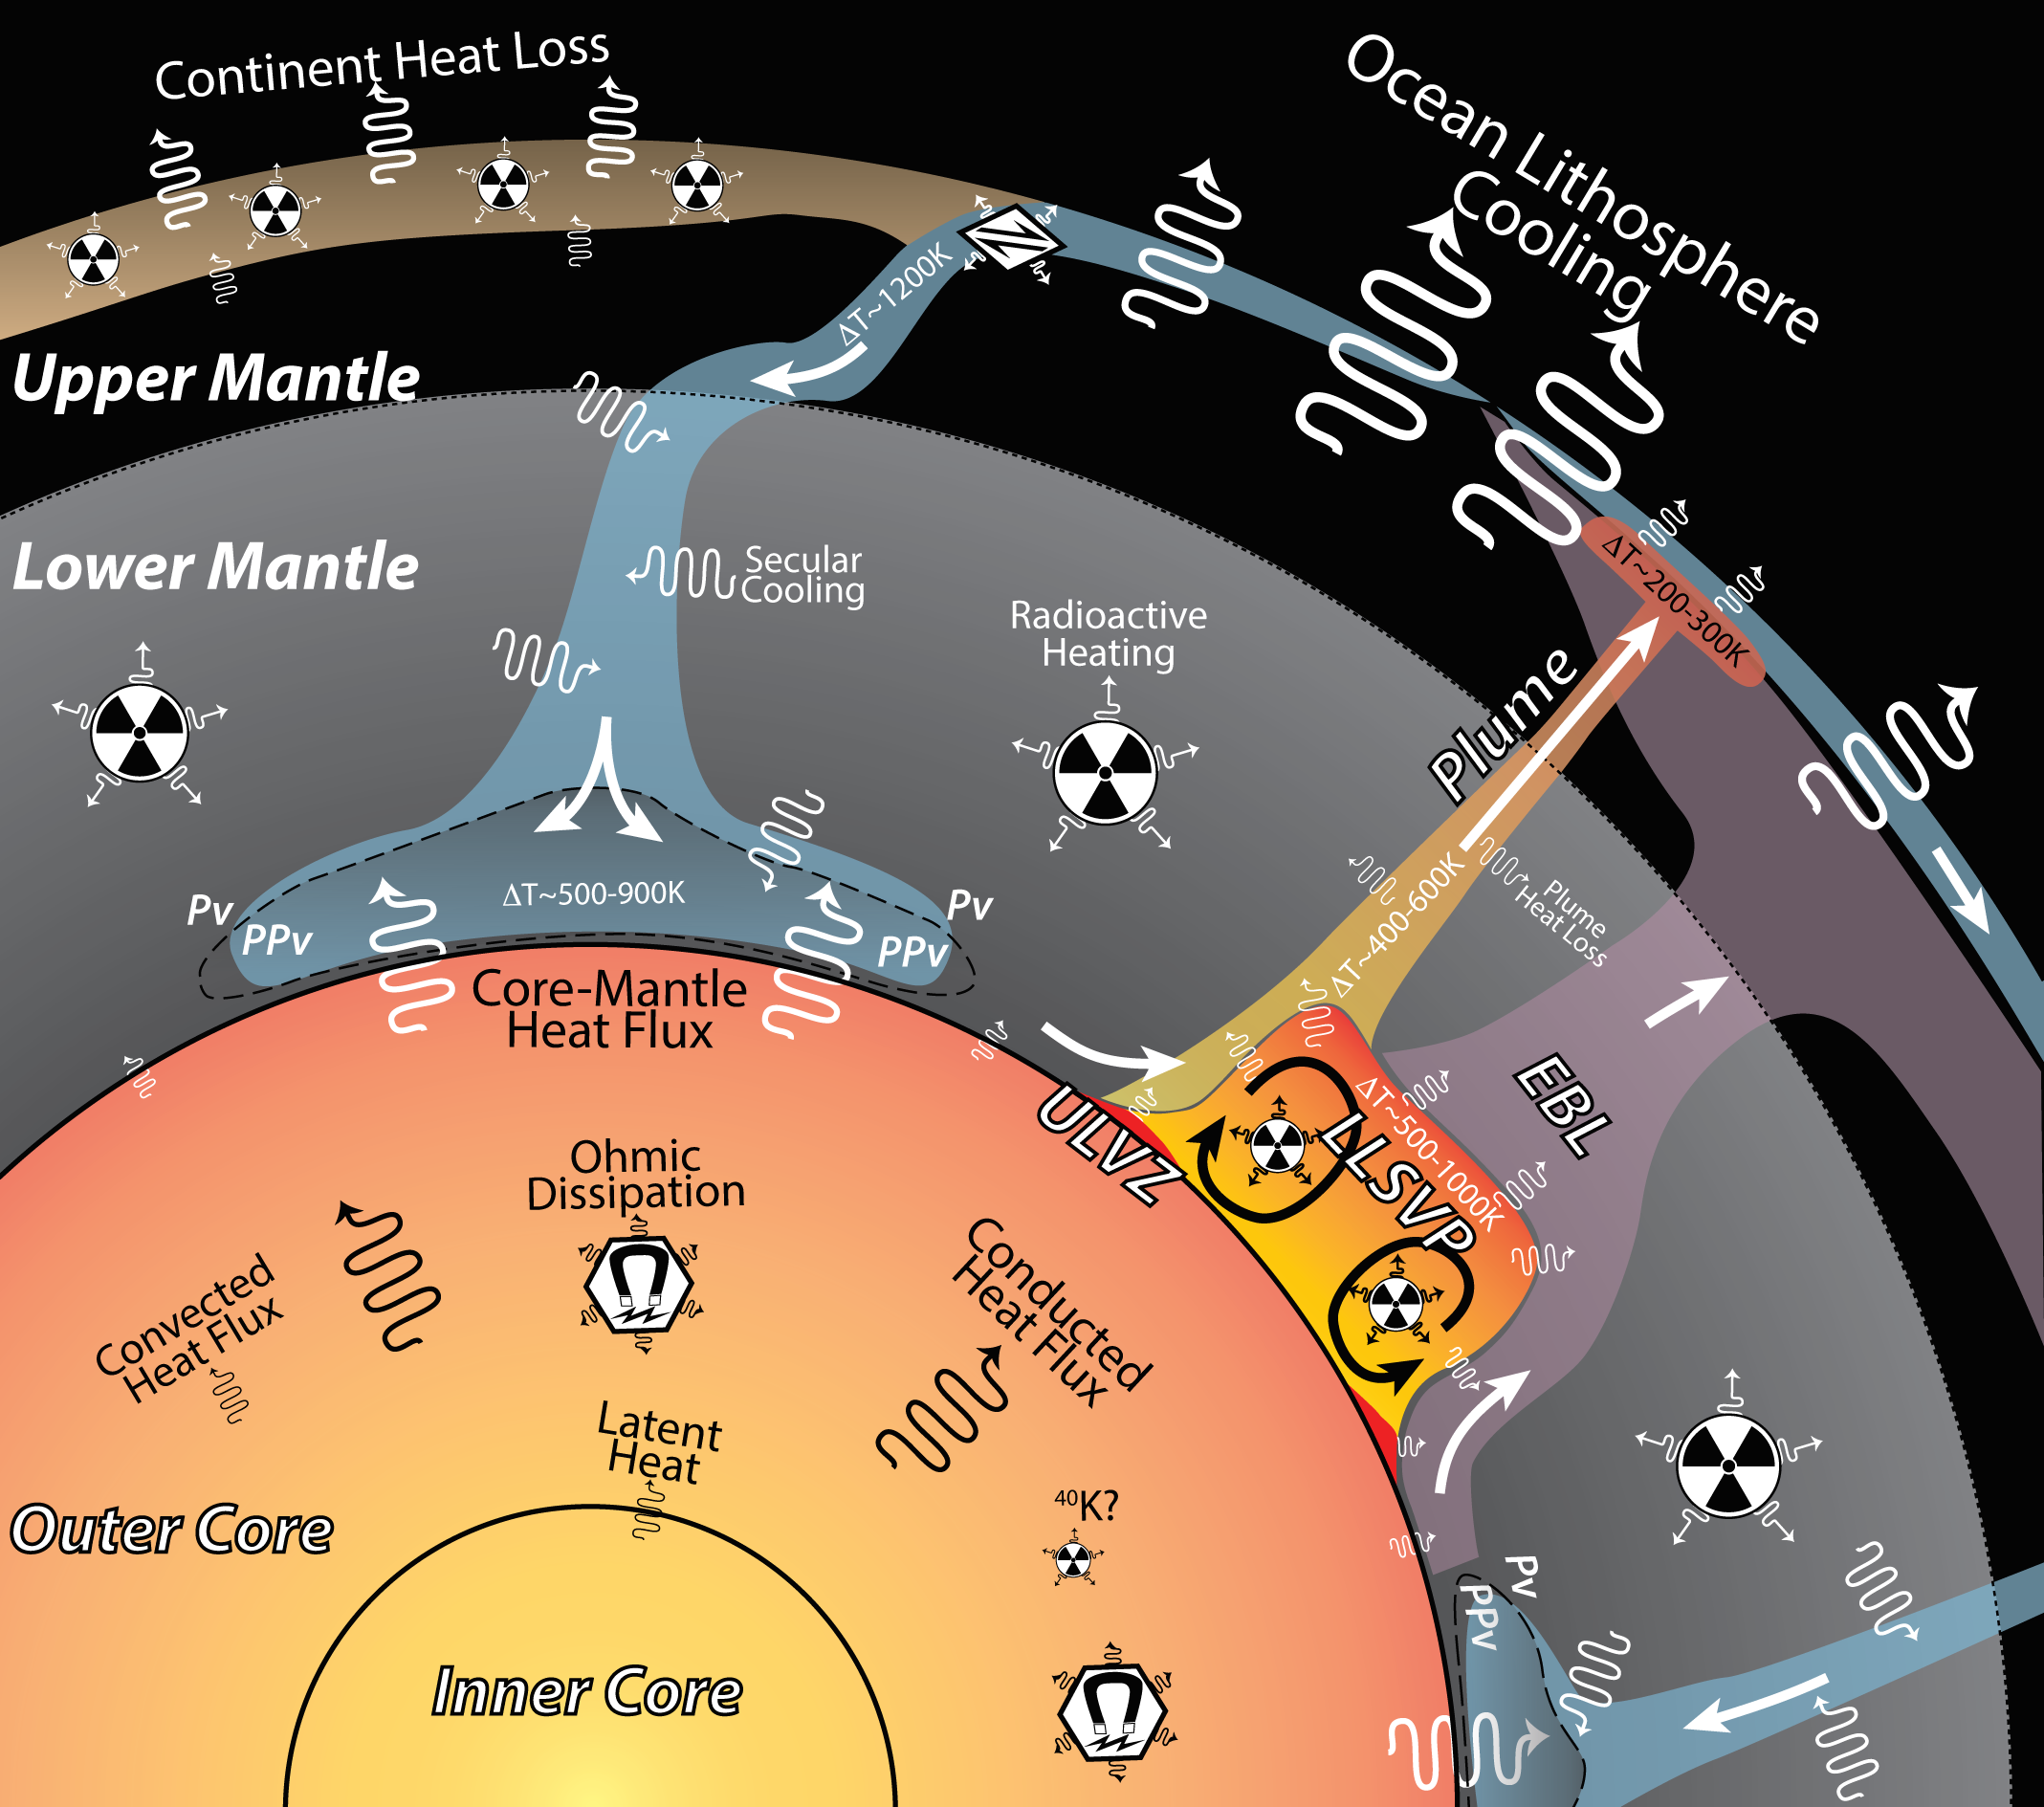
Your body
The matter that comprises your body circulates through the entire Earth system in deep space-time

Slide 12
A closer look at rocks
“The history of an entire mountain range is written in a single grain of sand”
—Paul Knauth
Rocks store a tremendous amount of information
Rock “memory” is the basis of the science of geology
Rocks record past processes

Slide 13
Rocks & DNA
“The most essential part of a living cell-the chromosome fibre may suitably be called an aperiodic crystal”
—Erwin Schrodinger (1943)
Some Similarities:
Store information
Information influences future events (active memory)
Equilibrium destroys information and function
Mutability
Some Differences:
Environment directly influences rocks, indirectly influences DNA
Rocks store vastly more information
DNA has more functionally dense info (more active than passive)
DNA replicates with ultra-high fidelity
DNA cycle much faster than rock cycle
Rocks are here from beginning, DNA had to develop over time

Slide 14
How do we sort this out?
A closer look at Process

Slide 15
A simple definition of “process”
Process
State A
State B
Process is a change of state
Note: We are interested in spontaneous natural processes, which obey certain rules (e.g., reduce free energy). Organizing processes with a human goal in mind is called process engineering (a very important field).

Slide 16
Examples of Simple Processes
Diffusion
Unmixed
Mixed
Strain
Undeformed
Deformed
Gravity
Higher Elevation
Lower Elevation

Slide 17
Process Collaboration
Rayleigh-Bénard Thermal Convection
Gravity
Thermal Expansion
Viscosity
Thermal Diffusion

Slide 18
Process Collaboration
Rock Weathering
Precipitation (e.g., Rain, Snow)
Thermal Expansion/Contraction
Wind
Freezing/Thawing
Dissolution/Exsolution
Plant growth/decay

Slide 19
Process Collaboration
Homo Sapiens
Respiratory
Nervous
Digestive
Muscular
Skeletal

Slide 20
Next Step: Memory

Slide 21
A simple definition of “memory”
Process
Process
Imprint
State A
State B
Memory is the recording/imprinting of process

Slide 22
Example of biological “memory”
Genetic Heredity
Father:
Son:

Slide 23
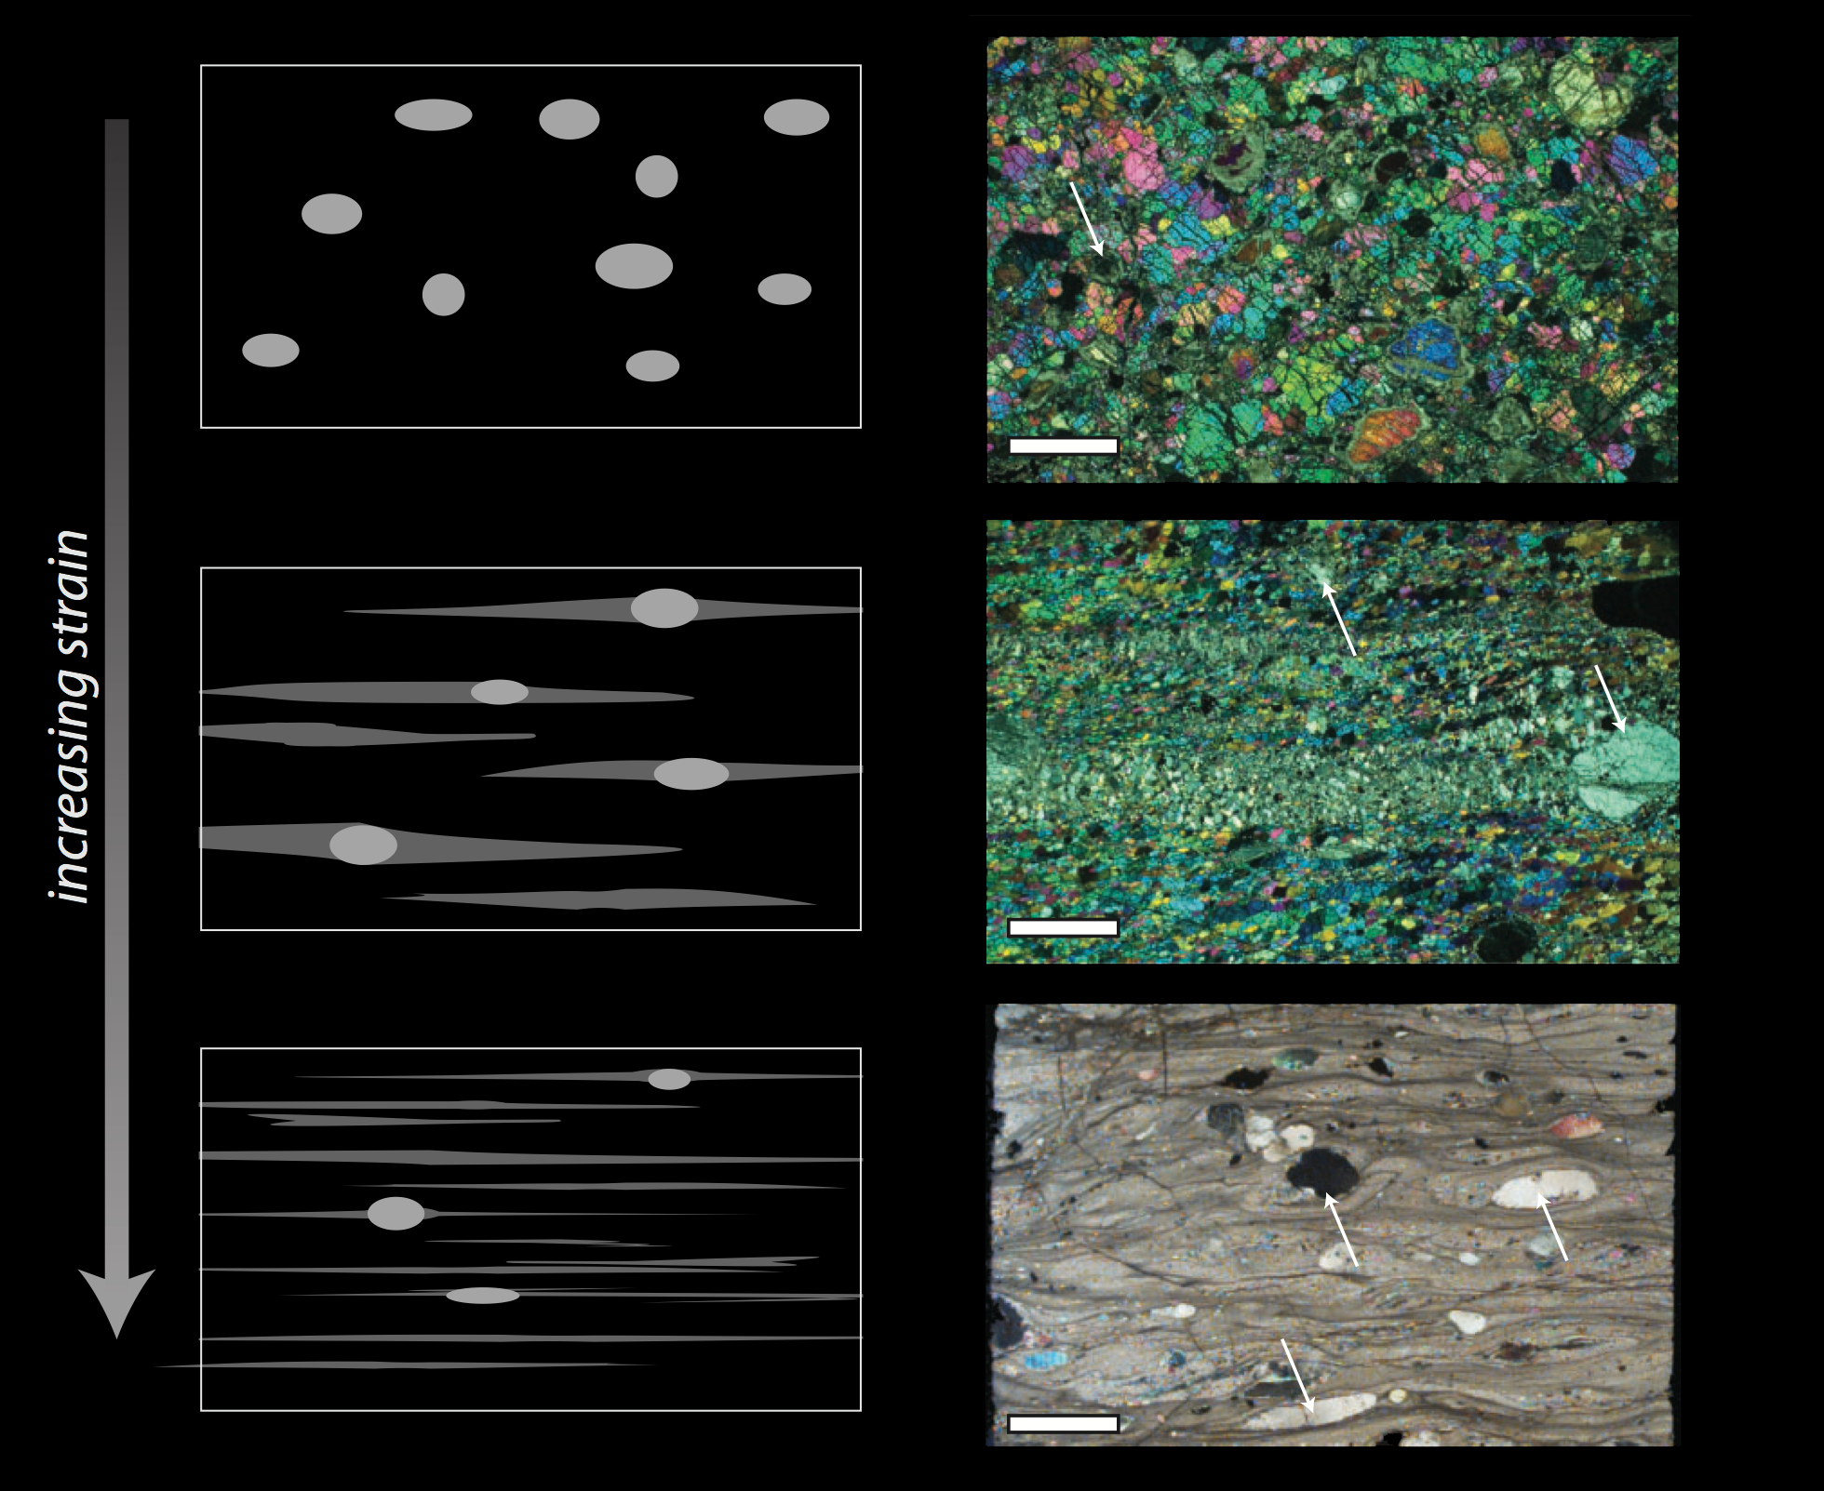
Example of geological “memory”
Deformation Fabric
Skemer et al. (2009), Warren & Hirth (2006)

Slide 24
Two kinds of memory
Process
Process
Imprint
State A
State B
Passive memory simply records the process
Process
Process
Imprint
State A
State B
Active memory is the feedback of imprinted information on process

Slide 25
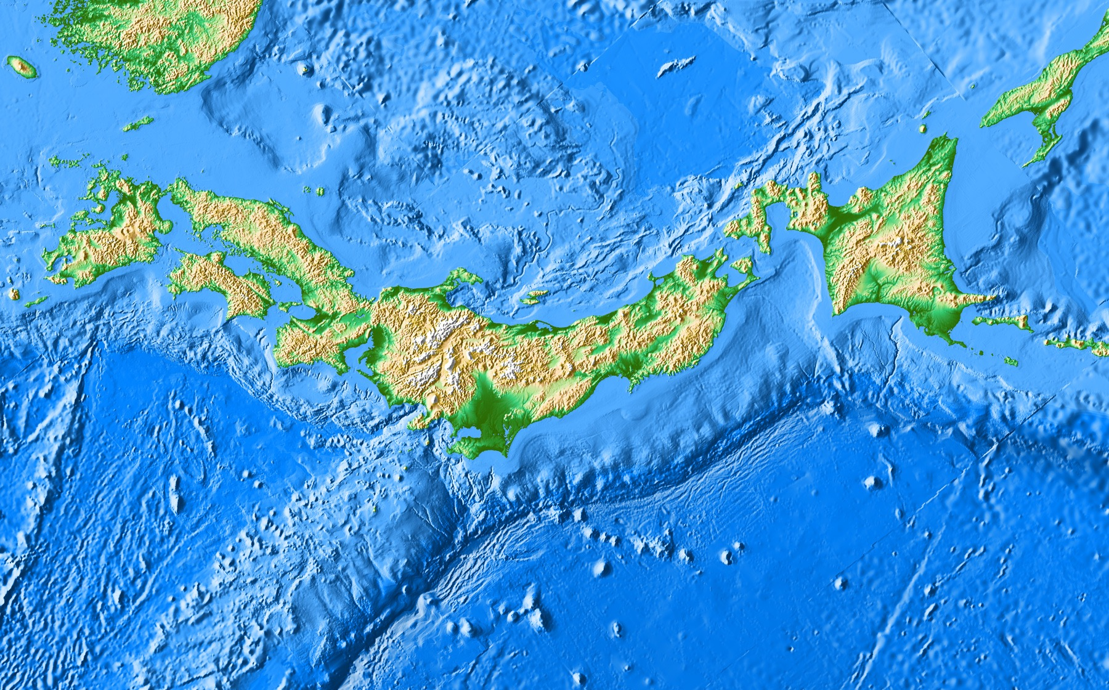

Slide 26
Mechanism of Tectonic Memory:
Strain Weakening and Localization
Experiment on octachloropropane crystal analogues

Slide 27
Life’s deep-time memory
Instead of directly imprinting memory onto the information substrate, life evolves memory by a process of variation and selection. Extinct lineages are forgotten, except perhaps through inference of their influence on horizontal gene transfer.

Slide 28
“Great blows to human
self-esteem”
Earth is not the center of the universe (Copernican Rev.)
Humans are part of the animal kingdom (Darwinian Rev.)
We are not as “free” as we’d like to think (Freudian Rev.)
…
There is no distinction between life and non-life (Future Rev.)
Sigmund Freud

Slide 29
Main Points
Life is an outgrowth/expression of a coupled open system of natural processes.
To understand this open system dynamic, a new kind of process science is required.
Process collaboration and memory are key components to build an approach that captures the essence of the open system.

Slide 30
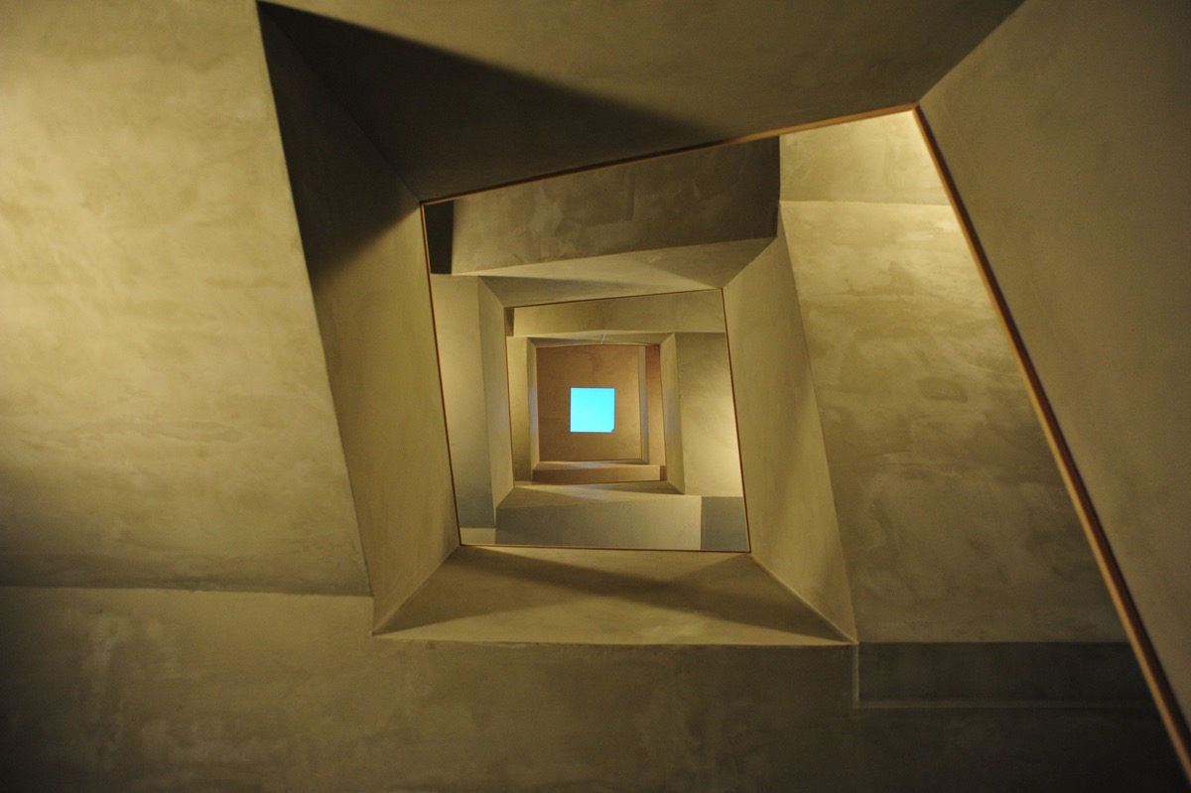
End of Slides

Slide 31
Planet
Life
Accretion
Prebiotic Chemistry
Magma Ocean
Memory Capacity
Progenote
Solid Mantle + Crust
Phylogenetic Tree

